Slide 1
Boxer Property
Final Presentation
Consultant Group 3
Aidan Schwartz, Andrew Shelton, MacKenzie Emerson, Pratik Nesarkar,
Sai Krishna, and Vatsa Kala

Slide 2
Table of Contents
01
02
03
04
05
06
CLIENT
CHALLENGE
CURRENT
PROCESS
PROPOSED SOLUTION
EXPECTED
BENEFITS
RISKS AND ASSUMPTIONS
SUMMARY AND CONCLUSION

Slide 3

Client Challenge
01

Slide 4
Why is Customer Retention Important?
Long-term profitability
Reduces vacancy costs
Ensures steady rental income

Slide 5
Challenges in Customer Retention
High Tenant Turnover & Short Lease Terms
Changing Tenant Expectations
Maintenance and Service Quality Issues
Competitive Pressure from Newer Developments
Notes:
Managers face challenges identifying and applying the most effective strategies to improve customer retention and lease renewal rates. Some of the challenges ar mentioned here.
—------------
[list multiple challenges and then the 1 or 2 we are really focusing on]
Overarching goal : Improving Customer Retention
Improving Manager Actions
Issues Taken Care

Slide 6
Why Maintenance & Service Quality Matters?
70%
of tenants consider moving due to poor maintenance
Word
of
Mouth
Service Quality
Reviews

Slide 7
Current Process
02

Slide 8
Current Process
*** not describing their process to them, just creating a sort of baseline to compare to our proposed process
Maybe mention some of the issues that led to needing a new process
Lack of data insights, managers performance inconsistencies, etc (though this is kind of already covered in the challenges section), customers not having feedback on progress of issue resolution

Slide 9
Proposed Solution
03

Slide 10
Next Best Action (NBA) Solution
Data Analytics & Identification of KPIs
Continuous Training from Manager Performance & Feedback
Ticket Progress Notifications & Feedback for Tenants
Automation of Issues & Increase in Proactive Solutions
Dashboard Integration within Current CRM System
Next Best Action (NBA)
Visualizations of Tenant & Property Data (Using PowerBi)
Listing of Open Tasks & Tickets

Slide 11
Next Best Action (NBA)
Next Best Action System
User Actions & Process Changes
System Inputs
Issue Segmentation
Historical Data
+
Real-Time Data
Simple
Medium
Complex
System Generated Next Best Action
Automatic Action
Manager Action
Manual Update
Automated Update
Tenant/Customer Notification
Notes:
Historical Data = Industry Best Practices, Supervised Learning (senior exec instruction), Unsupervised Learning (manager actions in the past)
Real-Time Data

Slide 12
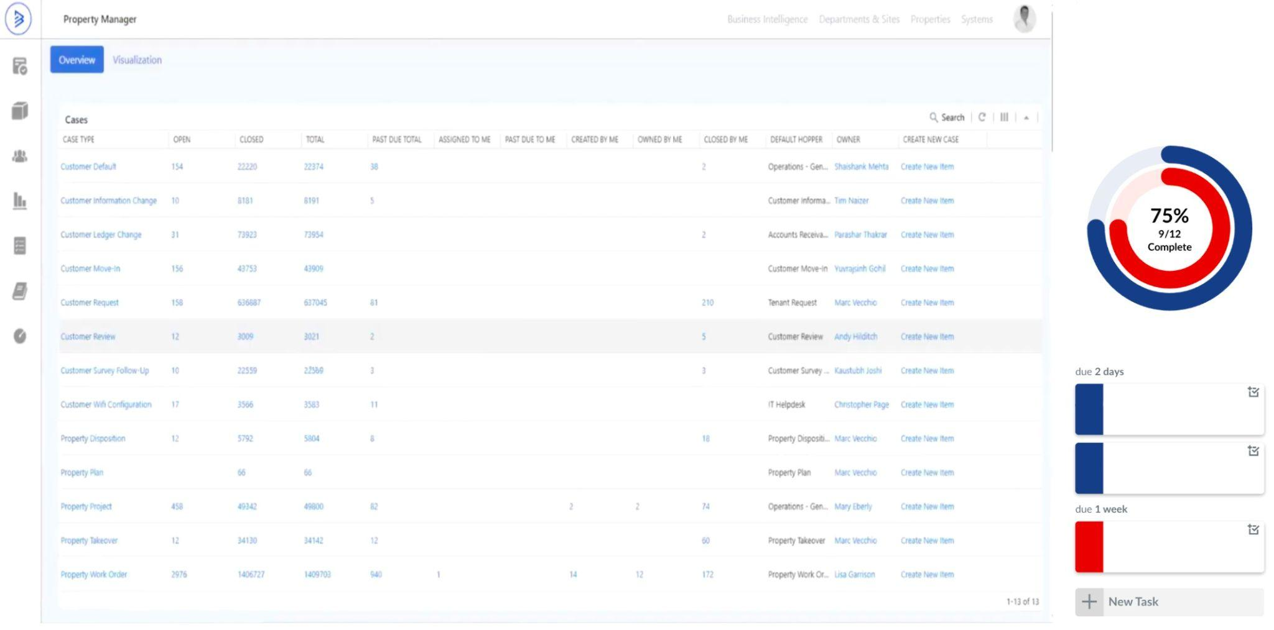
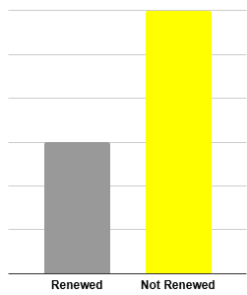

Sample Dashboard Integration
Next Best Actions:
Contact Leasing Team
Reply to Tenant A
Schedule Onboarding of Tenant B
2 Days Old
A/C Cold Call
Onboarding Request
1 Week Old
Access Card Request

Slide 13
Using Proactive Solutions
Identifying KPIs from the Boxer Property Dashboard
Using data to predict the NBA
Learning from Top Managers
Consistency of Performance
Providing New Opportunities
Reaching out to clients
Tiered Ticketing System
Automating Less Complex Issues

Slide 14




Underlying Technology
LLM Engine and Data Analytics
CRM System
Interactive Dashboards
Pulls Historical and real time data by using APIs.
Classifies of tickets using NLP and then generating data driven Next Best Actions (NBAs) using Gen AI.
Displays NBAs and key performance trends.

Slide 15
Underlying Technology
LLM Engine and Data Analytics
Classifies of tickets using NLP and then generating data driven Next Best Actions (NBAs) using Gen AI.
CRM System
Interactive Dashboards
Pulls Historical and real time data by using APIs.
Displays NBAs and key performance trends.

Slide 16
Expected Benefits
04

Slide 17
Benefits -
The Property Manager

Slide 18
Benefits -
The Customer

Slide 19
Risks and Assumptions
05

Slide 20
**Basic Template**
May need to include something about who is reviewing NBA recommendations
Also risk of manager pushback from automation (giving up control)
Maybe discuss initial training with 1 or 2 property managers to test and avoid risk of initial errors across an entire region of properties

Slide 21
Summary and Conclusion
06

Slide 22
Summary and Impact
Current Goal → Improve Current Customer Retention
Current Challenge → Inconsistent Performance by Managers When
Solving Customer Issues
Implementation of NBA System
Consistency of Manager Performance
Greater Current Tenant Satisfaction
and Renewal Rates
Notes:
Managers struggle to identify and apply the most effective strategies to improve customer retention and lease renewal rates.

Slide 23
Thank you!
Questions?

Slide 24
**Basic Template**

